Slide 1
www.MINEPORTAL.in
ONLINE TEST SERIES FOR
DGMS COAL/METAL FIRST/SECOND CLASS EXAM
GATE MINING EXAM
OVERMAN EXAM TEST
MINING INSPECTOR EXAMS
COAL INDIA MTs & OTHER PSUs EXAMS
FREE STUDY MATERIAL & VIDEO LECTURES
MINING JOBS NOTIFICATIONS
www.mineportal.in Call/Whatsapp-8804777500 www.fb.com/mineportal.in

Slide 2
Determining slope stability using Flac 3D

Slide 3
Slope stability
There are several methods to analyse slope which fails because its material shear strength on the sliding surface is insufficient to resist the actual shear stresses.
Factor of safety is a value that is used to examine the stability state of slopes. In other words, it is the ratio of collapse load to working load.
For FOS values greater than unity means the slope is stable, whereas, values lower than unity means unstable conditions.
A better definition for FOS will be the ratio of maximum available shear strength to the shear strength needed for equilibrium.
According to the shear failure, the factor of safety against slope failure is simply calculated as:
FOS= τ / τ_{f}
Where τ is the shear strength of the slope material, which is calculated through Mohr-Coulomb criterion as:

Slide 4

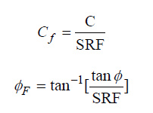
C stands for material cohesion where as Φ is the angle of internal friction.
Where τf is the shear stress along the sliding surface. It can be calculated as:
where the factored shear strength parameters C_{f} and Φ_{f} are:
where SRF is strength reduction factor. This method has been referred to as the ‘shear strength reduction technique’.

Slide 5
This technique is employed where the state of effective stresses in slope is calculated. By the use of this method, factor of safety calculations are done by progressively reducing the shear strength of the material to bring the slope to a state of limiting equilibrium.
A series of simulations are made using trial values of factor F_{trial} to reduce the cohesion, C, and friction angle, Ф, until slope failure occurs.

Slide 6
Types of slope failure
Plane Failure
Wedge Failure
Circular Failure
Toppling Failure

Slide 7
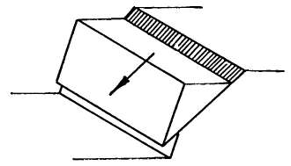
Plane Failure
Easiest form of rock slope failure
Occurs when a discontinuity striking approximately parallel to the slope face and dipping at a lower angle intersects the slope face
Variations on this simple failure mode can occur when the sliding plane is a combination of joint sets which form a straight path

Slide 8
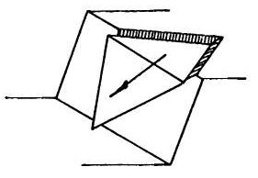
Wedge Failure
Occur when two discontinuities intersects in such a way that the wedge of material, formed above the discontinuities, can slide out in a direction parallel to the line of intersection of the two discontinuities
Common in the individual bench scale
Also provide the failure mechanism for a large slope

Slide 9
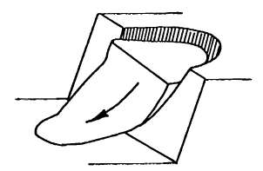
Circular Failure
Surface of the failure in spoil dumps or soil slopes resembles the shape of a circular arc
Occurs in soil slopes
The circular method occurs when the joint sets are not very well defined.
Failure is defined by a single discontinuity surface but will tend to follow a circular path

Slide 10
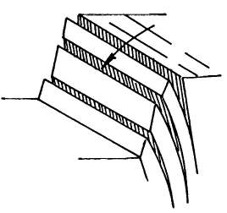
Toppling Failure
It occurs in slopes having near vertical joint sets
The stability depends on the stability of one or two key blocks
Cause of several failures ranging from small to large ones

Slide 11
Slope stability analysis technique
Limit Equilibrium Method
Finite Element Method

Slide 12
Limit Equilibrium Method
Limit equilibrium methods are still currently most used for slopes stability studies
These methods consist in cut- ting the slope into fine slices so that their base can be com- parable with a straight line then to write the equilibrium equations
The safety factor is given by using an iterative procedure

Slide 13
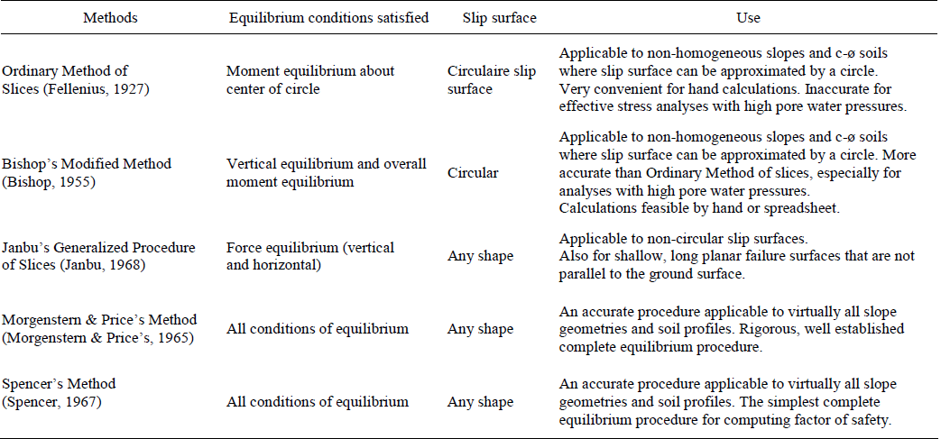
main limit equilibrium methods

Slide 14

Finite Element Method
The finite element method makes it possible to calcu- late stresses and deformations state in a rock mass
It uses the method of reduction of soil resistance properties, known as the “c-φ reduction” method.
At the failure stage of the slope, the total safety factor is given as

Slide 15
What is flac 3d
It’s full form is Fast Langrangian Analysis and Continua.
This is a software that is used to simulate real model conditions on desktop to estimate the behaviour of model under various applied conditions.
On solving the model, FLAC runs some steps. These calculation steps allow gravitational stresses to develop within the body and take simulation to equilibrium.
FLAC3D is an explicit dynamic code, we step the model through time (calculation time, not real time) allowing the kinetic energy of the mesh to damp out (thus providing the static solution we seek).
While stepping we can monitor maximum unbalanced force and maximum displacement in the system which when becomes constants are indicators that model has reached the equilibrium.

Slide 16
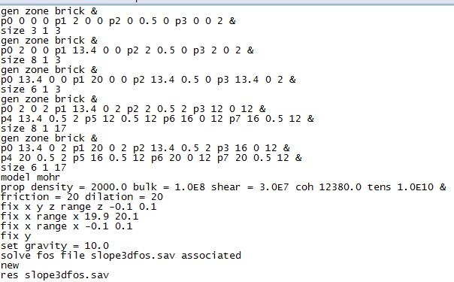
Program used for model

Slide 17
Explanation of program
FLAC makes model comprising of a no. of zones. Zones are nothing but a tetrahedral volume in shape of brick (in this case) which are treated as a single entity.
Here the whole model is coded in 4 parts. Each having their coordinates defined in 3 dimensions.
The model material is assumed to behave like mohr - coulomb model, failure criteria of which is explained in previous slides.
Properties of materials and boundary conditions of the model are defined.
Finally the gravity in the model is set as 10.0 in –z direction.
For solving the model solve fos is executed which in turn creates another file slope3d.sav after completion.
We will have to restore slope3d.sav file for further analysis.

Slide 18
fos file execution
The strength reduction method for determining factor of safety is implemented in FLAC3D through the SOLVE fos command.
This command implements an automatic search for factor of safety using the bracketing approach, as described in Dawson et al. (1999).
Several assumed failure surfaces are tested, and the one giving the lowest factor of safety is chosen.
First, the code finds a “characteristic response time”, which is a representative number of steps (denoted by Nr) that characterizes the response time of the system. Nr is found by setting the cohesion and tensile strength to large values, making a large change to the internal stresses, and finding how many steps are necessary for the system to return to equilibrium then, for a given factor of safety, F, Nr steps are executed.
If the unbalanced force ratio is less than 10−3, then the system is in equilibrium. The factor-of-safety solution stops when the difference between the upper and lower bracket values becomes smaller than 0.005. The strength reduction technique gives FOS with respect to geo-material shear strength.

Slide 19
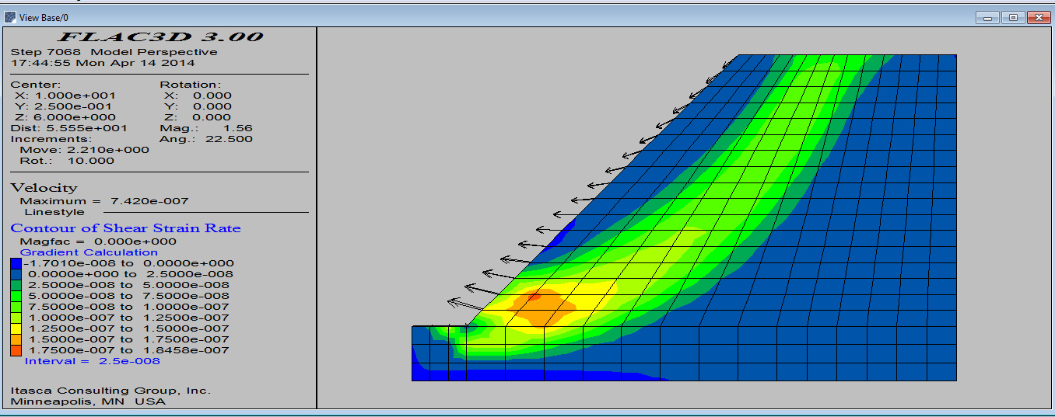
Shear strain-rate contours and velocity vectors in slope mode at last non equilibrium state

Slide 20
results
Above figure plots shear strain-rate contours and velocity vectors, which allow the failure surface to be identified.
Strain rate is the rate of change in strain (deformation) of a material with respect to time. It comprises both the rate at which the material is expanding or shrinking (expansion rate), and also the rate at which it is being deformed by progressive shearing without changing its volume (shear rate).
Many other plots can also be plotted like stress variations, z displacement and shear failures in model.
The factor of safety of this model is predicted to be 1.05.
The type of failure is circular failure.

Slide 21
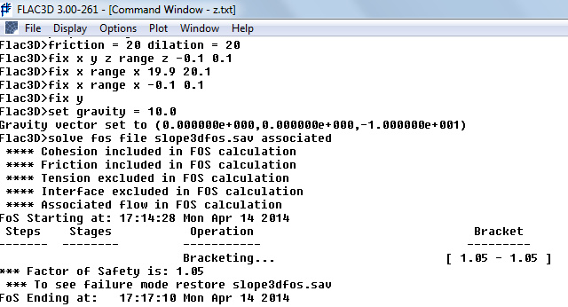

Slide 22
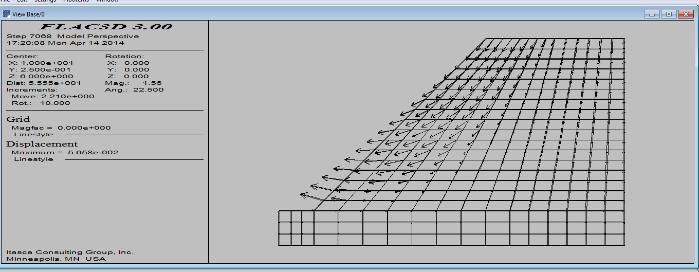
Z-displacement of zones

Slide 23
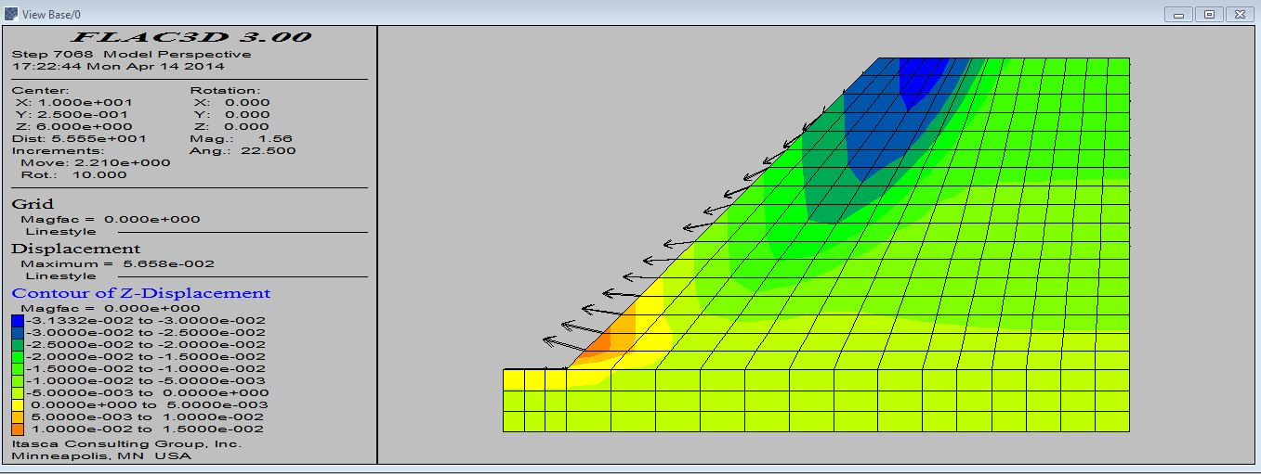
Contour of z-displacement

Slide 24
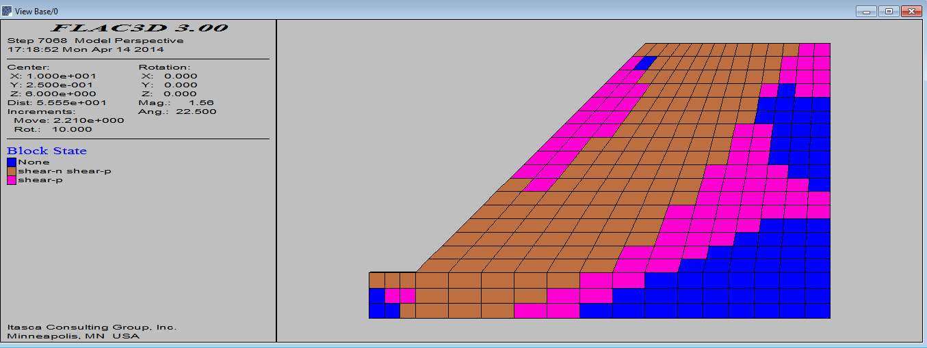
Shear failure zones

Slide 25
Thank you
Presented by
11108EN054-11108EN063

